Slide 1
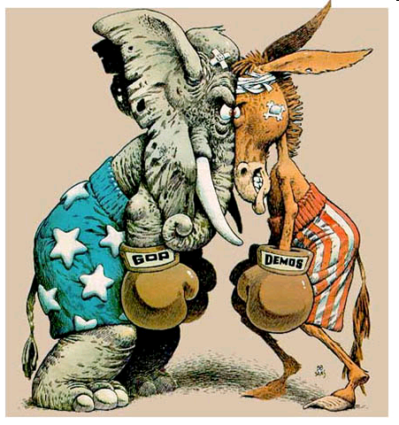
Political Parties

Slide 2
What is Your Ideology?
An ideology is a systematic set of values that enables a person to view policy issues in a consistent way.
*READ EACH STATEMENT & MARK TRUE OR FALSE

Slide 3
1. The federal government places to many restrictions on the way corporations conduct their businesses.

Slide 4
2. Unions reduce productivity by discouraging workers from performing tasks not agreed to in a labor management contract.

Slide 5
3. High government taxes discourage citizens from working hard.

Slide 6
4. Most people on welfare would prefer a real job.

Slide 7
5. Government should create programs that will reduce America’s large number of poor people.

Slide 8
6. The best way to help the poor is to set policies that help businesses earn a profit so they can hire the underprivileged.

Slide 9
7. Taxes should be used to redistribute income by taking from the wealthy & giving to the poor.

Slide 10
8. The government has a special responsibility to protect & assist disadvantaged minorities.

Slide 11
9. Government programs on behalf of the disadvantaged discourage people from helping themselves.

Slide 12
10. America’s high crime rate is directly traceable to the persistence of poverty & discrimination.

Slide 13
11. America’s high crime rate is due to courts being too lenient with criminals.

Slide 14
12. Crime, unemployment, & poverty will be reduced if Americans return to the traditional values of hard work, self discipline, & belief in God.

Slide 15
13. Government should censor or restrict films & publications that undermine the nation’s moral fiber.

Slide 16
Determining Your Ideology…
T= C, F=L
T=C, F=L
T=C, F=L
T=L, F=C
T=L, F=C
T=C, F=L
T=L, F=C
T=L, F=C
T=C, F=L
T=L, F=C
T=C, F=L
T=C, F=L
T=C, F=L

Slide 17
Political Ideologies
Ideology:
Set of ideas/views reflecting social needs, values, & ideals
Maintained by a group or an individual
Consistent & coherent—predictable
3 Main Forms…
Liberal
Moderate
Conservative

Slide 18
Political Ideologies
Liberal
(Favor Government
Involvement)
Moderate
(Opposed to
Extreme Views)
Conservative
(Favor Traditional
Values)

Slide 19
Terminology Review
Conservative: a person who doesn’t like change & who supports traditional, constitutional values
Liberal: a person whose political views are open to change & who supports government intervention in many areas of life.
Moderate: a person who doesn’t hold extreme political viewpoints & whose attitudes are between that of a conservative & a liberal

Slide 20
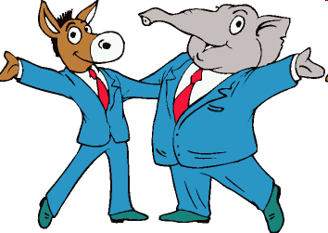
Political Ideologies & Political Parties
Political parties are concerned with winning elections
A person may have any of the 3 forms of political ideologies & be a member of either of the 2 major parties
NOT ISSUE-BASED

Slide 21
Political Party Membership
Republicans tend to be conservative
Democrats tend to be liberal
*Generalizations are risky
Independents aren’t loyal to either party (split-ticket voters)

Slide 22
Party Membership (*Statistically)
Democrats
Women
African Americans
Latinos
Labor Union Members
Lower Income Groups
Republicans
White Males
Asian Americans
Protestants
Business People
Middle to higher Income Groups

Slide 23
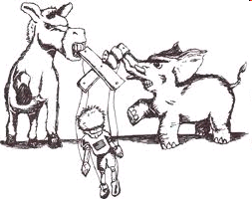
U.S. Political Parties
2-party system
Democrats
Republicans
Parties are instrumental in the administration of our government
Election-oriented NOT necessarily concerned with ideological foundation

Slide 24
POLITICAL PARTIES

Slide 25
REVIEW: Functions of Political Parties
Nominate candidates
Inform & activate voters
Provide a “seal of approval”
Govern
Act as a watchdog be sure candidates do the right thing

Slide 26
Why does the U.S. have a 2-party system?
History
Began with Federalists & Anti-Federalists
Tradition
Have always maintained 2 parties
Ideological Consensus
Most people have similar feelings about broad issues
No need for more than 2 parties
Electoral System
People don’t want to feel like they are “wasting” their votes

Slide 27
Other Political Options…
One-Party & Multiparty Systems

Slide 28
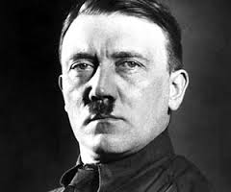
One-Party Systems
Really a “no-party” system
Exist in nearly all dictatorships
Party of the ruling clique is the only party

Slide 29
Multiparty Systems
Exist in most European democracies
Usually based on particular interests
Economic class, religion, political ideology, etc.
Tend to produce instability in government

Slide 30
Political Party Platforms

Slide 31
Terminology Review
Conservative: a person who doesn’t like change & supports traditional, constitutional views
Liberal: a person whose political views are open to change & who supports government intervention in many aspects of life.
Moderate: a person who doesn’t hold extreme political viewpoints & whose attitudes are inbetween.

Slide 32
Political Orientation
Democrats | Republicans
Usually more liberal More concerned about government control & more open to change | Usually more politically conservative Believe in less government control & more individual responsibility
BOTH parties have many of the same goals, but often have different ideas about obtaining them

Slide 33
What is a Party Platform?
Set of statements about what a candidate will do if elected
Statements of policy & promises

Slide 34
Taxes
Democrats | Republicans
Favor targeted tax cuts directed at lower income Americans Higher taxes on middle to high incomes. | Favor broad-based tax cuts
In 2001 & 2003, George W. Bush won passage of 2 of the largest tax cuts in U.S. history

Slide 35
Government Spending
Democrats | Republicans
Support larger federal spending programs administered from Washington | Favor reduced spending in the form of block grants to the states

Slide 36
Foreign Policy
Democrats | Republicans
Favor working through international organizations to combat terrorism United Nations NATO | Believe the U.S. has the right as a sovereign nation to act alone against threats “Bush Doctrine” Pre-emptive strikes when necessary

Slide 37
Abortion
Democrats | Republicans
Believe abortion should remain legal in all circumstances. Pro-Choice | Believe unborn children have the right to life, liberty and pursuit of happiness & oppose abortion. Pro-Life
Pro-Choice Republicans are considered moderate while Pro-Life Republicans are regarded as conservative

Slide 38
Affirmative Action
Democrats | Republicans
Support the use of preferential treatment to achieve racial diversity | Oppose race-based quotas & set-asides Support economic-based affirmative action

Slide 39
Social Security Reform
Democrats | Republicans
Oppose privatization & individual retirement accounts Oppose raising the age of retirement | Favor partially privatizing Social Security & the creation of individual retirement accounts Raise the age of retirement

Slide 40
Health Care
Democrats | Republicans
Support universal health-care coverage guaranteed by the federal government Government money for medical research such as stem cell research | Favor health maintenance organization reform & incremental coverage Promote health savings accounts No government money for stem cell research
BOTH parties support improving prescription drug benefits

Slide 41
Education
Democrats | Republicans
Favor increased federal spending & control Early learning & individual attention Better trained & paid teachers More student aid & tax credits | Favor less federal spending & control Raise academic standards More charter schools
In 1995, the Republican Congress tried to abolish the Department of Education

Slide 42
Minimum Wage
Democrats | Republicans
Support regular increases in the minimum wage | Oppose regular increases in the minimum wage
During the Clinton Administration, minimum wage went from $4.25 to $5.15—the largest increase during an 8 year period

Slide 43
Gay Marriage
Democrats | Republicans
Generally favor gay marriages, same-sex unions & gay rights | Believe in traditional marriage (between one man and one woman), oppose civil unions & gay rights

Slide 44
History of U.S. Political Parties

Slide 45
The Elephant & the Donkey
Thomas Nast
Political Cartoonist
Elephant
Strong & noble
Mighty
Donkey
Work horse
Dependable & trustworthy

Slide 46
The 2-Party System in American History
George Washington warned against “factions” in his Farewell Address
Political parties began during Washington’s administration & have become a force in elections ever since

Slide 47
Eras of Dominance
Between 1800 & today there have been 4 eras in which one party or the other has dominated national politics
Much of the current era has been marked by a split in party control of the White House & Congress

Slide 48
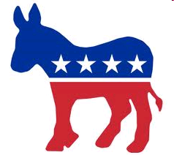
The Eras of Domination
Democrats 1800-1860
Farmers, planters, debtors, pioneers
Opposed by Federalists, Whigs, & Republicans
Thomas Jefferson
James Madison
James Monroe
Andrew Jackson
Martin Van Buren
James K. Polk
Franklin Pierce
James Buchanan

Slide 49
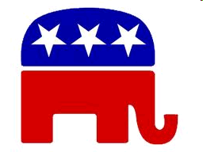
The Eras of Domination
Abraham Lincoln
Andrew Johnson
Ulysses S. Grant
Rutherford B. Hayes
James A. Garfield
Chester Arthur
Benjamin Harrison
William McKinley
Teddy Roosevelt
William Taft
Warren G. Harding
Calvin Coolidge
Herbert Hoover
Republicans 1860-1932
Supported by Northern & Western farmers, African Americans, & businessmen
Democrats controlled the South at this time

Slide 50
The Eras of Domination
Democrats 1932-1968
Supported by Southerners, small farmers, organized labor, minorities, & big cities
Led by FDR’s New Deal gov’t. following the Great Depression
FDR
Harry S. Truman
JFK
Lyndon B. Johnson

Slide 51
The Eras of Domination
New Era: Divided 1968- Now
Republicans have dominated the White House
Democrats have controlled Congress
Divided government
Richard Nixon
Gerald Ford
James Carter
Ronald Reagan
George H.W. Bush
Bill Clinton
George W. Bush
Barack Obama

Slide 52
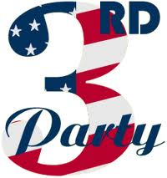
The Minor Parties

Slide 53
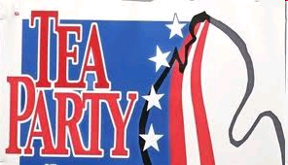
Minor Parties
AKA “Third Parties”
Introduce useful innovations in American politics
Unlike major parties, tend to take clear-cut stands on controversial issues

Slide 54
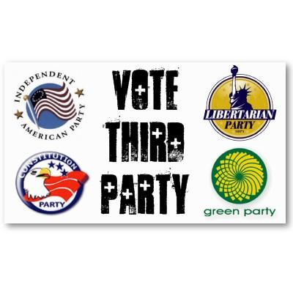
The Role of Minor Parties
“Spoiler”
Can potentially cost a major party candidate the election
Critic
Speak out against the actions of the major parties
Reformer/Innovator
Propose ideas that are sometimes adopted by the major parties
Notes:
54

Slide 55
The Short Life Span of Minor Parties
Discouraged by major parties
Difficulty qualifying for the ballot in some states—limits their growth
Difficulty setting up national & state organization
Electoral System favors major parties
Winner-take-all
Issues are often absorbed by major parties

Slide 56
4 Types of Minor Parties
Ideological
Single-Issue
Economic Protest
Splinter

Slide 57
TYPES OF MINOR PARTIES

Slide 58
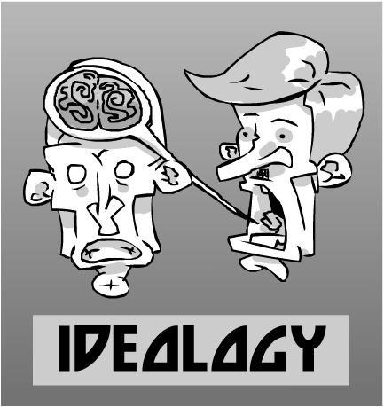
Ideological Parties
Based on a set of beliefs (an ideology)
Economic
Social
Political

Slide 59
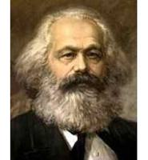
Ideological Parties
Most have been built on Karl Marx’s ideas (Marxist thought)
Socialist Party
Socialist Labor Party
Communist Party

Slide 60
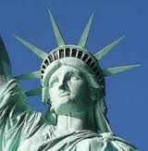
Ideological Parties
Sometimes centered on emphasizing personal freedom
Libertarian Party
Black Panther Party

Slide 61
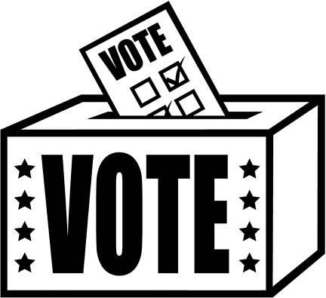
Ideological Parties
Don’t often win elections
Longest-lived type of minor party
Ideologies are consistent—don’t change!

Slide 62
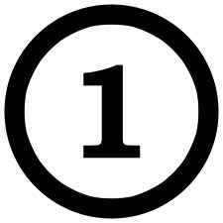
Single-Issue Parties
Focus on one-issue
Usually take name from that issue
Right to Life Party
Prohibition Party
Marijuana Party

Slide 63
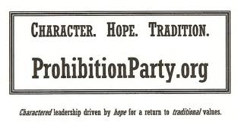
Single-Issue Parties
Very-short life span
Die after issue fades or interest in issue ends
Sometimes major parties take on key issues

Slide 64
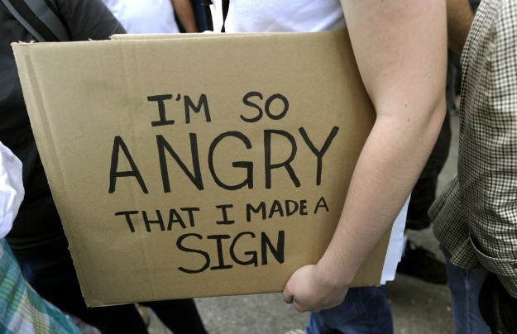
Economic Protest Parties
Appear during tough financial times
Appeal to those that are angry about money issues
Reform Party
Working Families Party
Populist Party
Greenback Party

Slide 65
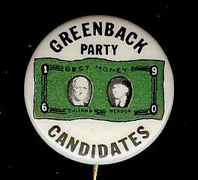
Economic Protest Parties
Demand better conditions from major parties
Short life span
Disappear when things improve economically

Slide 66
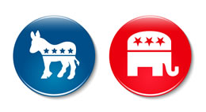
Splinter Parties
Parties that have broken away from one of the major parties

Slide 67
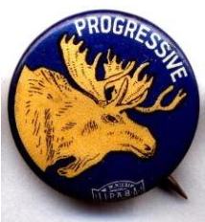
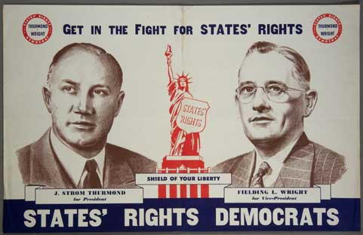
Splinter Parties
Usually led by strong leader who didn’t get the major party’s nomination
Dixiecrats (Henry Wallace)
Bull Moose (Teddy Roosevelt)

Slide 68
Splinter Parties
Short life span
Fade & collapse when the leader steps aside

