Slide 1
Unit 1 Foundations of American Government
Chapter 1: Principles of Government

Slide 2
What is “government?”
-The institution through which a society makes and enforces its public policies. What are public policies?
There are many different types of governments… Can we name a few? In which type of government do we live and practice in the United States?

Slide 3
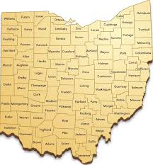
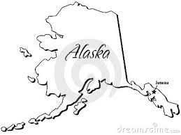
State= What does this word mean?
Separation of Church
and….
-Not so much. In government, state is considered a body of people in a particular place that has the authority to create and enforce law.

Slide 4
What does sovereign mean??
-the state has the ability to supreme and ultimate power within its own territory.
-Has there ever been a state take advantage of this?
-What was done? Has another nation ever stepped in to stop it?

Slide 5
Writing v. Government
How can writing play any part in government?
See map on Pg. 5

Slide 6
Preamble
What is it?
-Please read pages 7 and 8 in small groups and we will come back together as a class and discuss.

